Slide 1
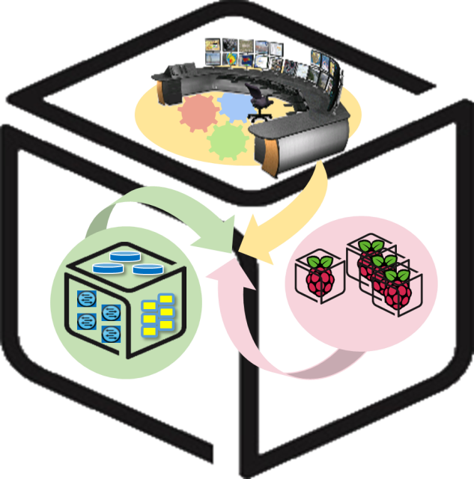
Computer Systems Lab.
Computer Systems Lab @ Spring 2016

Slide 2





CSLab: Analytics LAB
Data Processing & Visualization
Data

Slide 3

Analytics Lab
- Final Goal
Install Mesos, Spark, Zeppelin on NUC
Data Processing with Spark & Zeppelin

Slide 4
Week 1
Mesos, Spark and Zeppelin: Introduction and Configuration

Slide 5
Apache Mesos - Concept
What is Mesos?
A distributed systems kernel
Mesos is built using the same principles as the Linux kernel, only at a different level of abstraction. The Mesos kernel runs on every machine and provides applications (e.g., Hadoop, Spark, Kafka, Elastic Search) with API’s for resource management and scheduling across entire datacenter and cloud environments.
Cloud as a single computer
Share resources across the machines
…

Slide 6
Apache Mesos - Architecture
1
I need 2 CPUs!
Framework
3
Framework, use 2 CPUs in Slave 1
Mesos Master
2
I have 2 CPUs
Mesos Slave 1
Mesos Slave 1
Mesos Slave 1

Slide 7
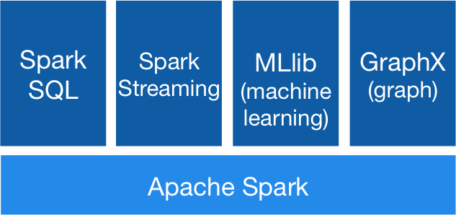
Apache Spark - Concept
Apache Spark™ is a fast and general engine for large-scale data processing.
In-memory data processing framework: Fast!
Easy to use, community fastly growing
Libraries: SQL and DataFrame, Streaming, MLlib, GraphX
Run on standalone or Mesos, Yarn, etc
Scala, Java, Python

Slide 8
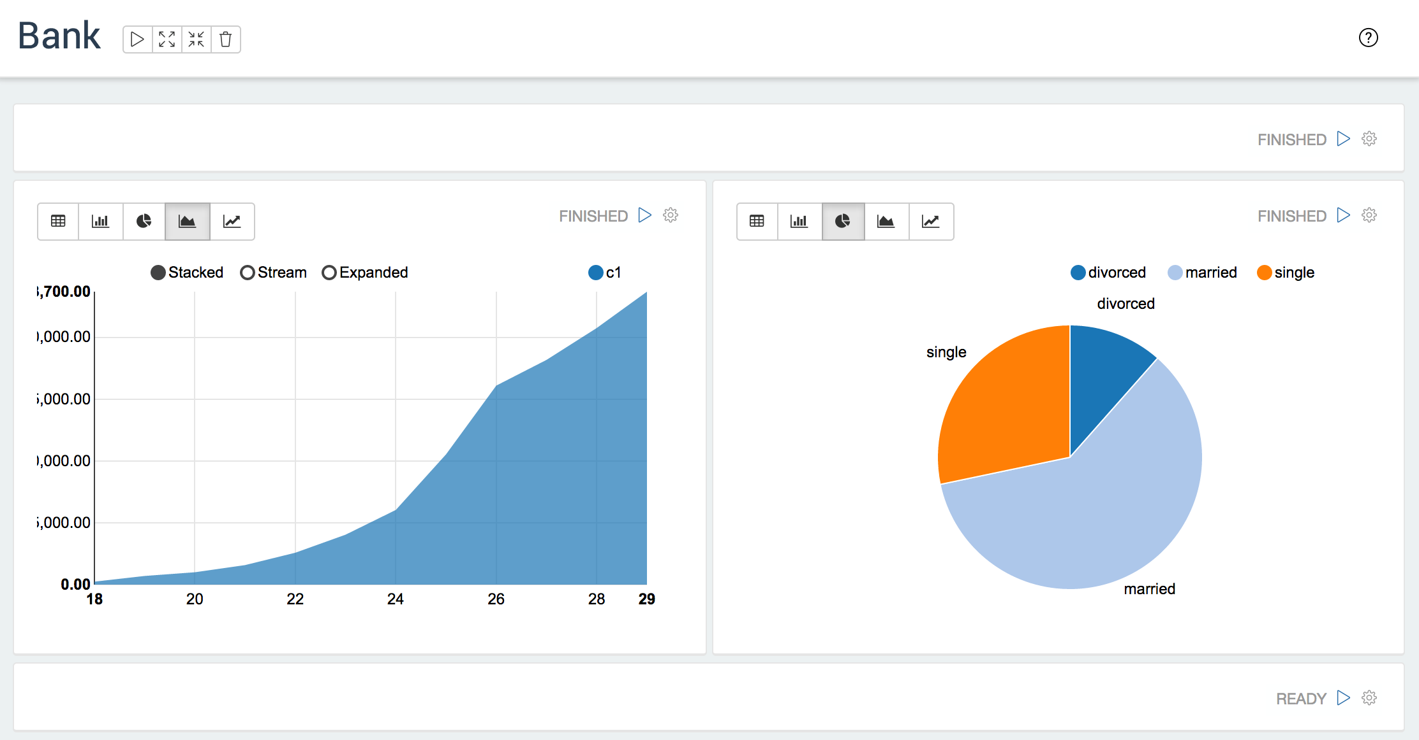
Apache Zeppelin
-Concept
A web-based notebook that enables interactive data analytics.
Support Spark

Slide 9

1. Apache Mesos - Install & Configuration
Mesos Master
Mesos Slave

Slide 10
1. Apache Mesos - Install
Prerequest: Ubuntu must be 64bit
sudo apt-key adv --keyserver keyserver.ubuntu.com --recv E56151BF
DISTRO=$(lsb_release -is | tr '[:upper:]' '[:lower:]')
CODENAME=$(lsb_release -cs)
echo "deb http://repos.mesosphere.io/${DISTRO} ${CODENAME} main" | sudo tee /etc/apt/sources.list.d/mesosphere.list
sudo apt-get -y update

Slide 11
1. Apache Mesos - Install: Mesos Master
sudo apt-get -y install mesos marathon
sudo reboot
sudo service mesos-slave stop
echo manual | sudo tee /etc/init/mesos-slave.override
echo <IP_ADDR> | sudo tee /etc/mesos-master/ip
echo <IP_ADDR> | sudo tee /etc/mesos-master/hostname
echo zk://<IP_ADDR>:2181/mesos | sudo tee /etc/mesos/zk
echo <YOUR_NAME> | sudo tee /etc/mesos-master/cluster
sudo service zookeeper restart
sudo service mesos-master restart
sudo service marathon restart
echo 1 | sudo tee /etc/zookeeper/conf/myid

Slide 12
1. Apache Mesos - Install: Mesos Slave
sudo apt-get -y install mesos
sudo reboot
sudo service mesos-master stop
echo manual | sudo tee /etc/init/mesos-master.override
sudo service zookeeper stop
echo manual | sudo tee /etc/init/zookeeper.override
sudo apt-get -y remove --purge zookeeper
echo <SLAVE_IP_ADDR> | sudo tee /etc/mesos-slave/ip
echo <SLAVE_IP_ADDR> | sudo tee /etc/mesos-slave/hostname
echo zk://<MASTER_IP_ADDR>:2181/mesos | sudo tee /etc/mesos/zk
sudo reboot

Slide 13
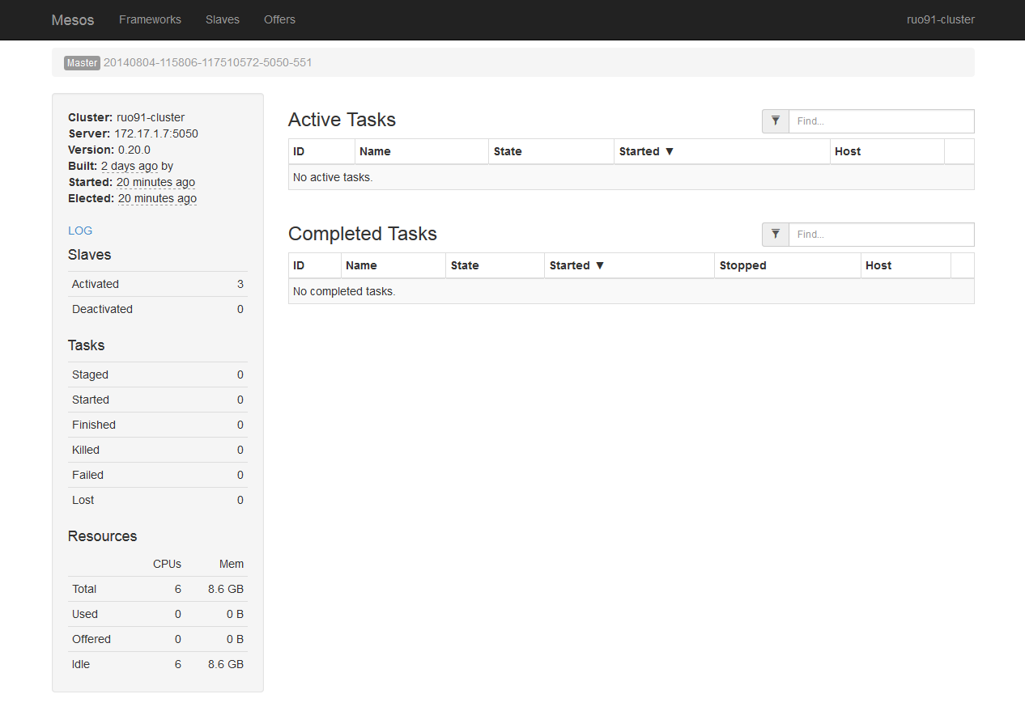
1. Apache Mesos - Web UI
http://<MASTER-IP-ADDR>:5050

Slide 14
2. Apache Spark - Install
※ Install on every NUC
wget http://mirror.apache-kr.org/spark/spark-1.5.2/spark-1.5.2-bin-hadoop2.6.tgz
tar xzf spark-1.5.2-bin-hadoop2.6.tgz
cd spark-1.5.2-bin-hadoop2.6
cd spark-1.5.2-bin-hadoop2.6/conf/
cp spark-env.sh.template spark-env.sh
vi spark-env.sh
export MESOS_NATIVE_JAVA_LIBRARY=/usr/local/lib/libmesos.so
export MASTER=mesos://<MESOS MASTER IP ADDR>:5050
Edit:
# Test Spark
cd ..
bin/pyspark
data = range(1, 10001)
distData = sc.parallelize(data)
distData.filter(lambda x: x < 10).collect()
Go to Mesos web UI and see Spark framework running.

Slide 15
3. Apache Zeppelin - Install (on Mesos)
wget http://mirror.apache-kr.org/incubator/zeppelin/0.5.5-incubating/zeppelin-0.5.5-incubating-bin-all.tgz
tar xzf zeppelin-0.5.5-incubating-bin-all.tgz
cd zeppelin-0.5.5-incubating-bin-all/conf
cp zeppelin-env.sh.template zeppelin-env.sh
vi zeppelin-env.sh
cd ..
bin/zeppelin-daemon.sh start
export MESOS_NATIVE_JAVA_LIBRARY=/usr/local/lib/libmesos.so
export MASTER=mesos://<MESOS MASTER IP ADDR>:5050
Edit:
http://<IP-ADDR>:8080

Slide 16
3. Apache Zeppelin - Install (standalone mode)
If you have trouble running Zeppelin on Mesos, you can run Zeppelin in standalone mode.
rm conf/zeppelin-env.sh
bin/zeppelin-daemon.sh start #(or if daemon is already running, use ‘restart’ instead of ‘start.’)
http://<IP-ADDR>:8080

Slide 17
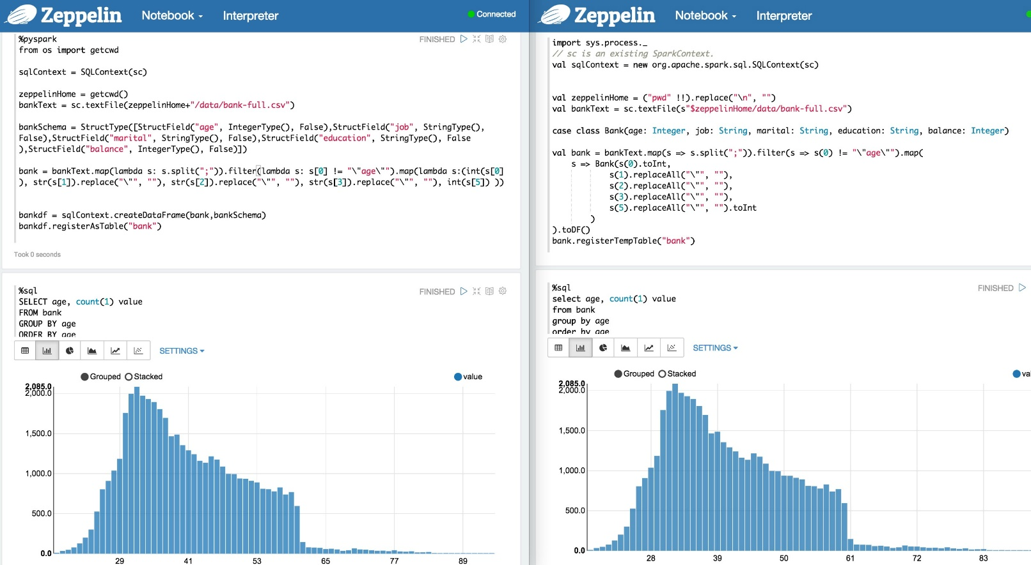
3. Apache Zeppelin - Run Big Data Job
Press ‘Run’ button to test the sample codes.

Slide 18

Week 2
More about Spark and Zeppelin
Big data processing

Slide 19
Tip. Pyspark: Spark in Python - Sample
# In zeppelin directory, make data directory and download sample data file.
$ cd zeppelin-0.5.5-incubating-bin-all
$ mkdir data
$ cd data
$ wget https://s3.amazonaws.com/apache-zeppelin/tutorial/bank/bank.csv
Zeppelin tutorial converted to pyspark
%pyspark
from pyspark.sql.types import *
zeppelinHome = os.getcwd()
bankText = sc.textFile(zeppelinHome + "/data/bank.csv")
bankSchema = StructType([StructField("age", IntegerType(), False),
StructField("job", StringType(), False),
StructField("marital", StringType(), False),
StructField("education", StringType(), False),
StructField("balance", IntegerType(), False)])
bank = bankText.map(lambda s: s.split(";")).filter(lambda s: s[0] != "\"age\"").map(lambda s: ( int(s[0]),
str(s[1]).replace("\"", ""),
str(s[2]).replace("\"", ""),
str(s[3]).replace("\"", ""),
int(s[5])))
bankdf = sqlContext.createDataFrame(bank, bankSchema)
bankdf.registerTempTable("bank")

Slide 20
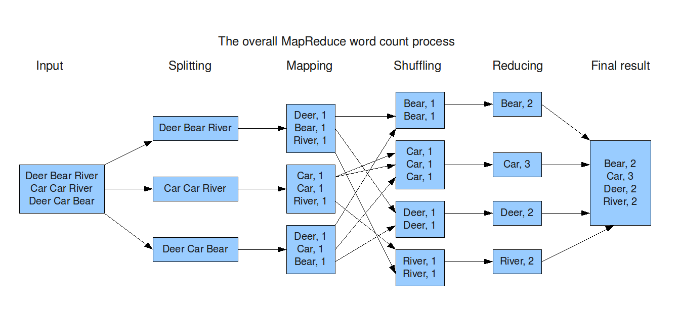
2. Processing Big Data - Map and Reduce

Slide 21
2. Processing Big Data - Map and Reduce in Spark
RDD (Resilient Distributed Datasets): a distributed memory abstraction that allows programmers to perform in-memory computations on large clusters while retaining the fault tolerance of data ﬂow models like MapReduce.
class pyspark.RDD
map()
groupBy(), groupByKey()
reduce(), reduceByKey()
join()
sort(), sortByKey()
union()
…
http://spark.apache.org/docs/latest/api/python/pyspark.html

Slide 22
3. Apache Zeppelin
- Wordcount
# Prepare data
cd zeppelin-0.5.5-incubating-bin-all
mkdir data
cd data
wget https://www.dropbox.com/s/dvtrxdr8am49yvv/wordcount.txt
# wordcount.txt: Remarks by President Obama at Hankuk University (https://www.whitehouse.gov/the-press-office/2012/03/26/remarks-president-obama-hankuk-university)

Slide 23
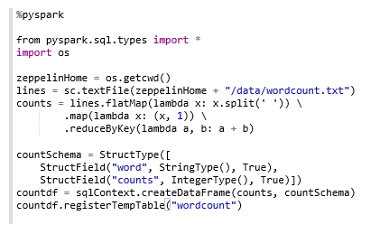
3. Apache Zeppelin - Wordcount
?
Hint: filter(), map(), reduceByKey() and page 20
(If you have trouble using Zeppelin, restart Zeppelin daemon.)
$ bin/zeppelin-daemon.sh restart

Slide 24
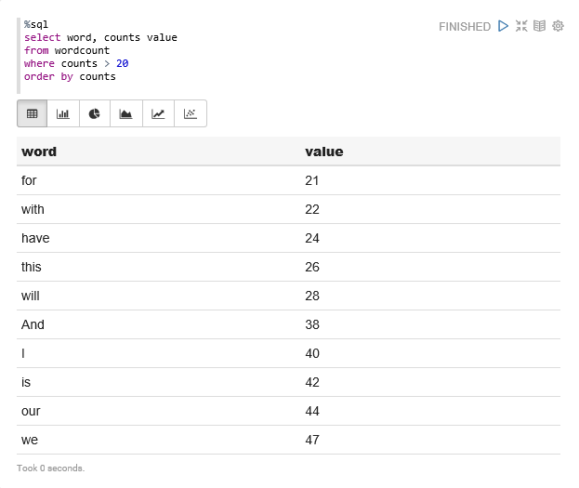
3. Apache Zeppelin - Wordcount (Result)

Slide 25
3. Apache Zeppelin - Data Cleaning
Actually, there are 26 ‘have’, 37 ‘this’ in wordcount.txt
We need to remove punctuation marks like ‘.’, ‘,’, etc.
It can be done by re.sub() and map() functions.
Add some codes to make dirty data clean and get the right answer.
This is to make complex model simple, or get better answer.

Slide 26
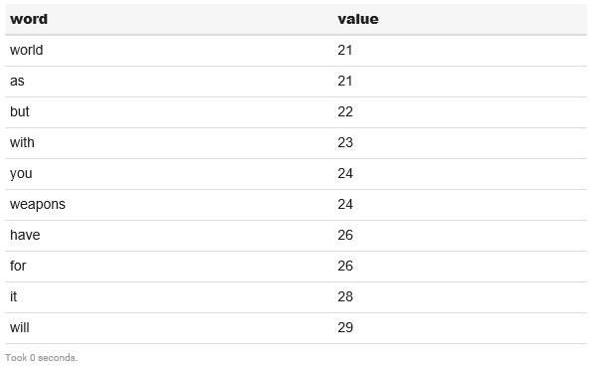
3. Apache Zeppelin - Wordcount (fixed)

Slide 27
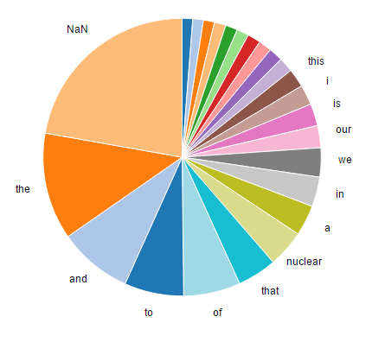
3. Apache Zeppelin - Wordcount - graph

Slide 28
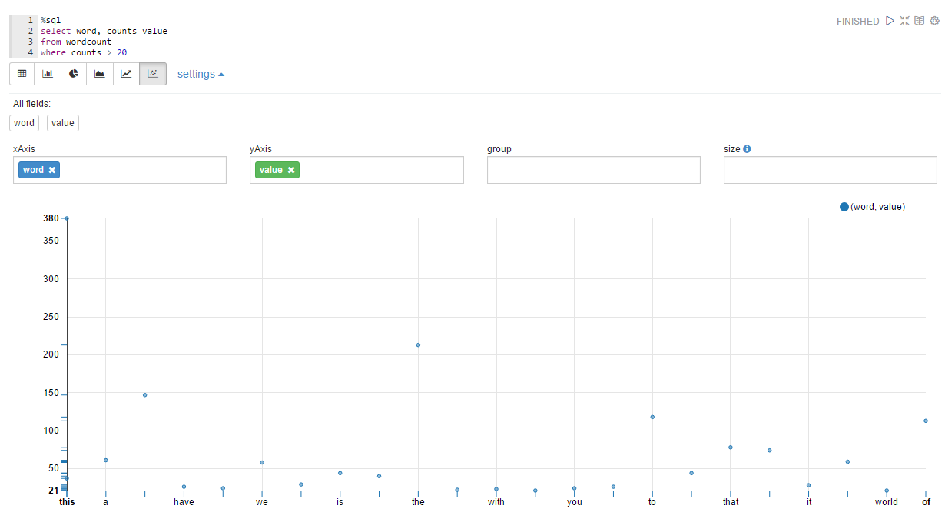
3. Apache Zeppelin - Wordcount - graph

Slide 29
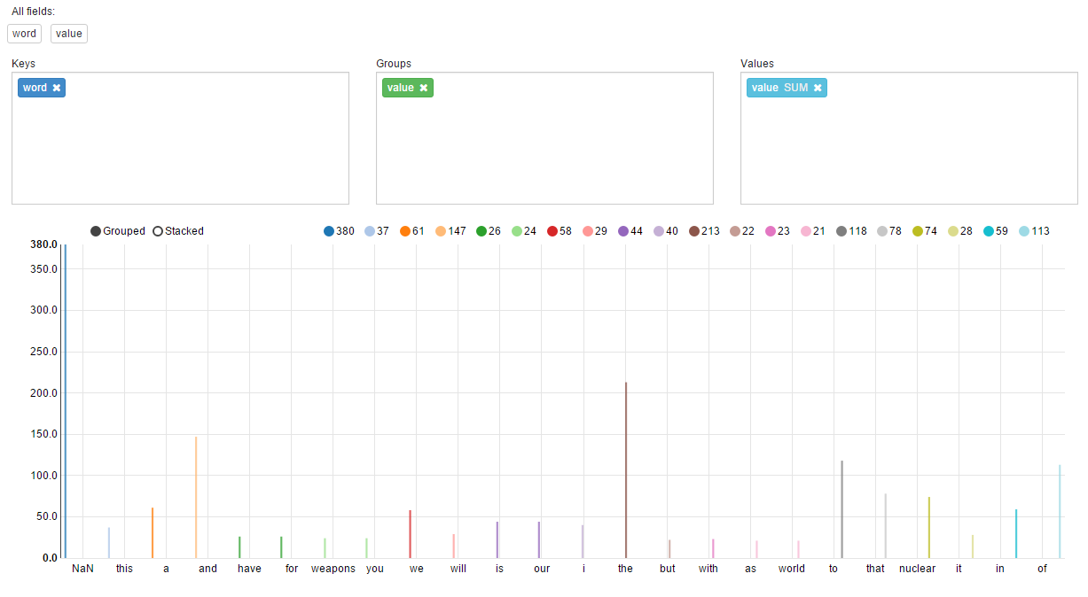
3. Apache Zeppelin - Wordcount - graph

Slide 30

Thank You for
Your Attention
Any Questions?

